Slide 1
Correlation and Linear Regression
Week 4, Computational Genomics

Slide 2
Examining gene expression of two genes
So far, we have looked at the association of gene expression and mutation status. What if we want to look at how similar two gene’s expression are across cell lines?
When two continuous variables are associated, we say that they are correlated.
We have various tools to measure these associations: each tool has its assumptions and interpretation.
Notes:
Increase of one gene implies increase or decrease of the other gene

Slide 3
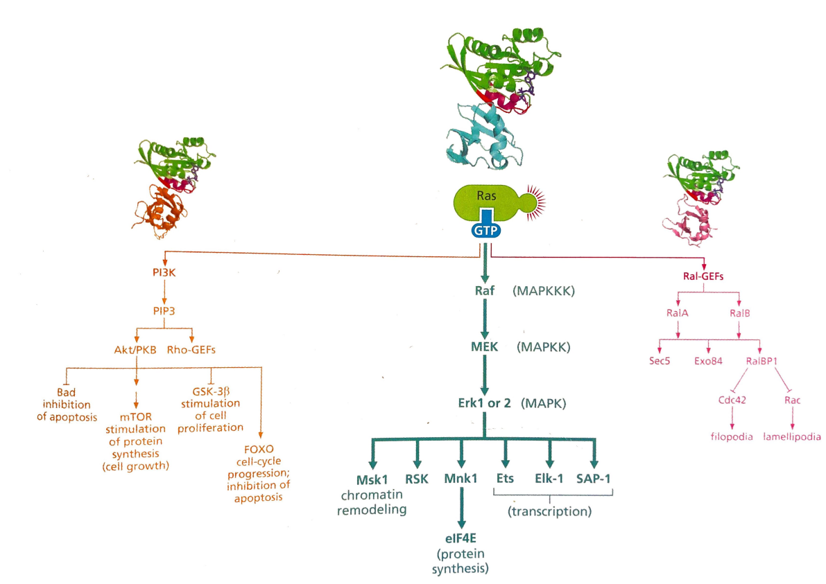
Ras, PI3K expression relationship

Slide 4
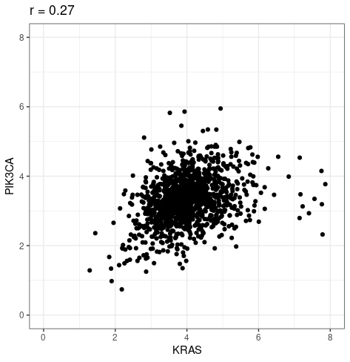
Measuring correlation
Measures the linear relationship between two continuous variables.
cor(expression$KRAS,
expression$PIK3CA)
Notes:
PI3 kinase pathway

Slide 5
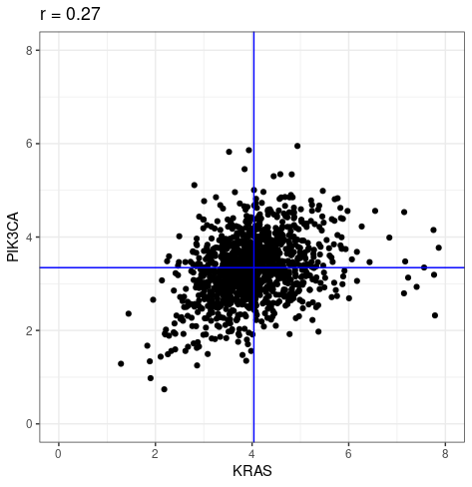
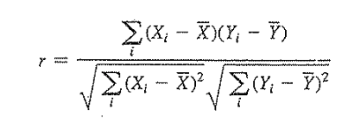
Measuring correlation
Measures the linear relationship between two continuous variables.
Notes:
Explain the four quadrants and how it contributes to positive and negative values for r.

Slide 6
Properties of correlation coefficient
Is a measurement of how close the points are to the line.
Is between -1 and 1.
Has no units.
Is unaffected by unit changes or swaps in axis.
Notes:
Spearman correlation - measures monotone relationship.

Slide 7
Correlation viewed as a statistic
After all, it is another way of summarizing a sample, just as difference of two group means is a statistic for the two sample T-test.
Confidence intervals, hypothesis testing can be made, but not common in practice due to needed assumptions.

Slide 8
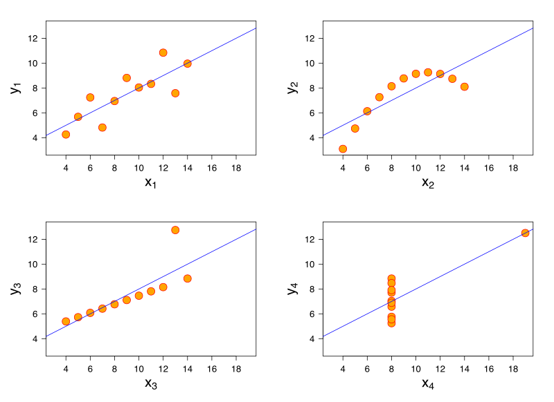
Notes:
Anscombe's quartet
Assumptions for using correlation as a metric:
Data comes from a linear relationship,
with equal amount of variance around it
Continuous variables

Slide 9
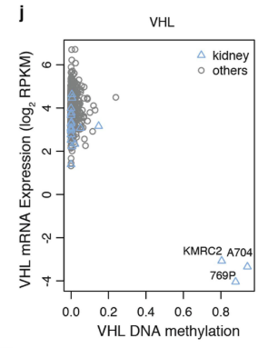
Notes:
From Ghandi et al. Next gen. of CCLE

Slide 10

Genomewide correlation: which pairs of genes are most correlated?

Slide 11
http://guessthecorrelation.com/

Slide 12
Correlation tells us how linear the relationship is, linear regression tells us which line it is.
A model to:
Understand how each unit of the independent variable is associated with the dependent variable.
“If we observe an unit change in KRAS expression, how much more or less unit change will we see in PIK3CA expression?”
Notes:
Now, we are labeling each measurement as independent or dependent.
Why do you think I am labeling KRAS as independent, and PIK3CA as dependent?

Slide 13
Correlation tells us how linear the relationship is, linear regression tells us which line it is.
A model to:
Understand how each unit of the independent variable is associated with the dependent variable.
“If we observe an unit change in KRAS expression, how much more or less unit change will we see in PIK3CA expression?”
To predict the dependent variable given a new independent variable.
“Given a new cell line that we measure KRAS expression, can we predict its PIK3CA expression?”
Notes:
Explain what the independent variable and dependent variable are

Slide 14
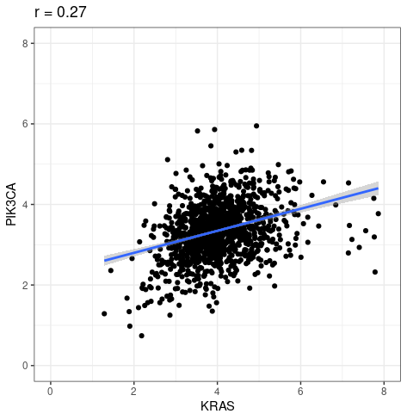
This is done through a line of “best fit”.
Y = a + bX
a is the y-intercept
b is the slope:
ΔPIK3CA/ΔKRAS
Notes:
If X is discrete, then we get the T-test back!

Slide 15
> lm(PIK3CA~KRAS, expression)
Coefficients:
(Intercept) KRAS
2.5131 0.2061
Notes:
Can you interpret it?
We can also make predictions.

Slide 16
> summary(lm(PIK3CA~KRAS, expression))
Coefficients:
Estimate Std. Error t value Pr(>|t|)
(Intercept) 2.51308 0.08519 29.498 <2e-16 ***
KRAS 0.20607 0.02063 9.991 <2e-16 ***
---
Signif. codes: 0 ‘***’ 0.001 ‘**’ 0.01 ‘*’ 0.05 ‘.’ 0.1 ‘ ’ 1

Slide 17
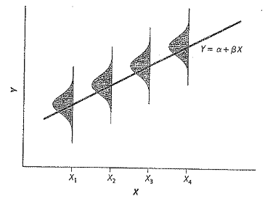
Assumptions for linear regression
For each value of X, the mean(Y) lies on the regression line.
For each value of X, the distribution of Y is “Normal”.
For each value of X, var(Y) is the same.
Notes:
We have looked at how to interpret linear regression - but it has assumptions.
A regression line isn’t useful if the data isn’t linear!
The assumption isn’t that the data has to be perfectly linear - it just has to be somewhat close in order to make use of the tool.
Not every value of Y has to be on the line - but the mean has to be.

Slide 18
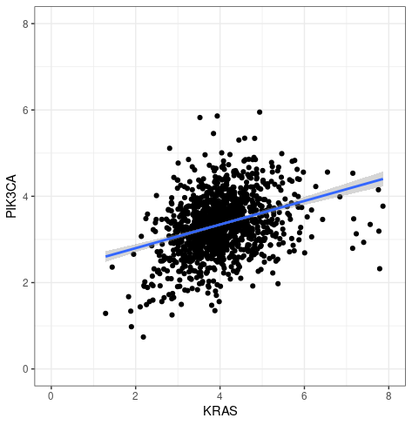
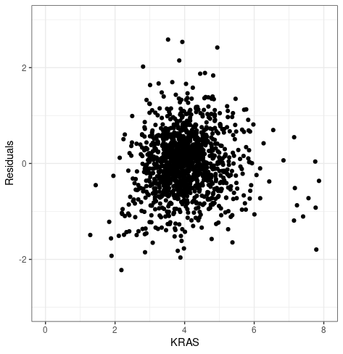
Does the data follow our assumptions?
residual = distance of observed Y to regression line
Is the residual is centered symmetrically around 0?
Does the residual varies constantly across the independent variable?
Notes:
If the residual association with independent variable is not linear - say, a curve, then it suggests that the mean of Y relative to X isn’t on a line.

Slide 19
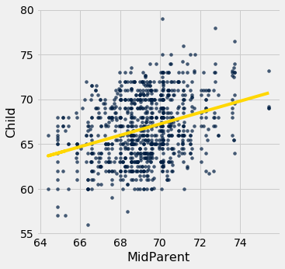
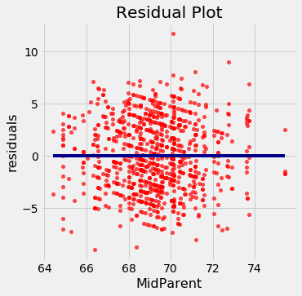
Does the data follow our assumptions?
residual = distance of observed Y to regression line
Is the residual is centered symmetrically around 0?
Does the residual varies constantly across the independent variable?

Slide 20
Genomic information associates predicts dependency and drug sensitivity
Drug sensitivity
Gene knock-out
Genomics
(KRAS-mut, lung cancer)
Notes:
KRAS example.
Ultimately, in precision medicine, we won’t be working with cell lines.
We are working with patient’s genomic profile, and there is no dependency or drug sensitivity data to figure out what genes are sensitive to knock-out, or what drugs target which gene.
Association vs. prediction - given a new patient sample + genomics, can we predict what gene dependency and drug sensitivity?
If we can build a model to predict dependency or drug sensitivity using genomic data, that’s powerful.

Slide 21
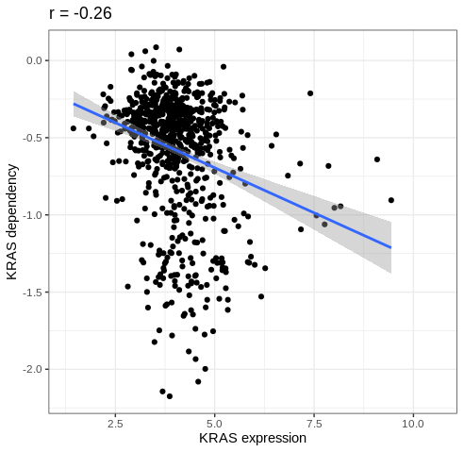
Does KRAS expression predict KRAS dependency?
lm(KRAS_dependency~KRAS_expression, analysis)
Coefficients:
(Intercept) KRAS_expression
-0.1113 -0.1167
Notes:
For each value of X, the mean(Y) lies on the regression line.
For each value of X, the distribution of Y is “Normal”.
For each value of X, var(Y) is the same.

Slide 22
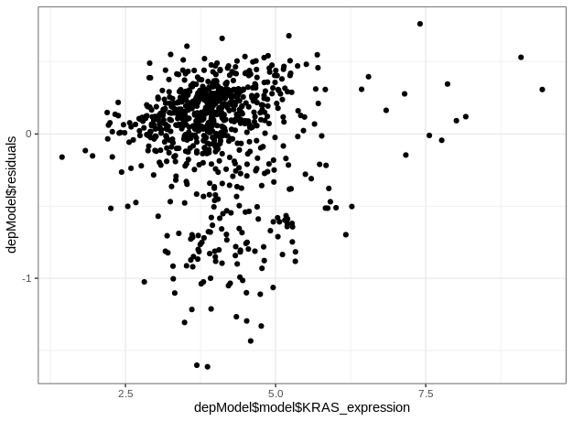
Does KRAS expression predict KRAS dependency?
Notes:
For each value of X, the mean(Y) lies on the regression line.
For each value of X, the distribution of Y is “Normal”.
For each value of X, var(Y) is the same.

Slide 23
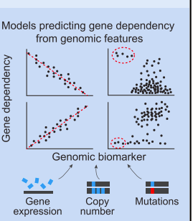
“Building a Cancer Dependency Map”
“Most human epithelial tumors harbor numerous alterations, making it difficult to predict which genes are required for tumor survival. To systematically identify cancer dependencies, we analyzed 501 genome-scale loss-of-function screens....We found predictive models for 426 dependencies (55%) by nonlinear regression modeling considering 66,646 molecular features. Many dependencies fall into a limited number of classes, and unexpectedly, in 82% of models, the top biomarkers were expression based...Together, these observations provide a foundation for a cancer dependency map that facilitates the prioritization of therapeutic targets.”
Notes:
Tsherniak et al. (2017)

Slide 24
“Building a Cancer Dependency Map”
Y = a + b1 * gene1 + b2 * gene2 + …. + b20000*gene20000
Notes:
Multiple linear regression assumptions
X_i are independent
For each value of X_i, the population of Y values’ mean lies on the regression line; the relationship is linear.
For each value of X_i, the distribution of possible Y values is “normal”.
The variance of Y values is the same for all values of X_i.
How might this be violated in this model?
Consequences of this violation:
Inaccurate false positives, false negatives
Inaccurate relationships
Allude to variable selection techniques

Slide 25
biological question <-> computational analysis
What variations do we see in Gene X within a population?
Is mutation of gene X associated with the development of a certain cancer?
Which genes are most differentially expressed under gene X’s mutation?
What biological pathways are associated with a set of genes?
Does gene X’s expression associate with gene Y’s expression?
Is gene X associated with gene Y’s deletion?
Notes:
Can you fill out any of this right now?
By the end of the course, we want you be able to fill these out, and be able to implement it in code!

